Slide 1
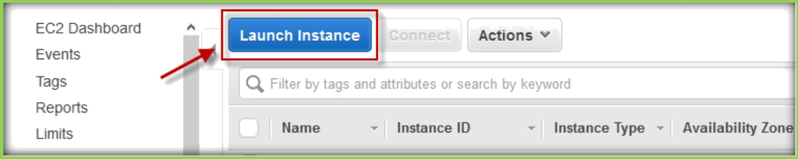
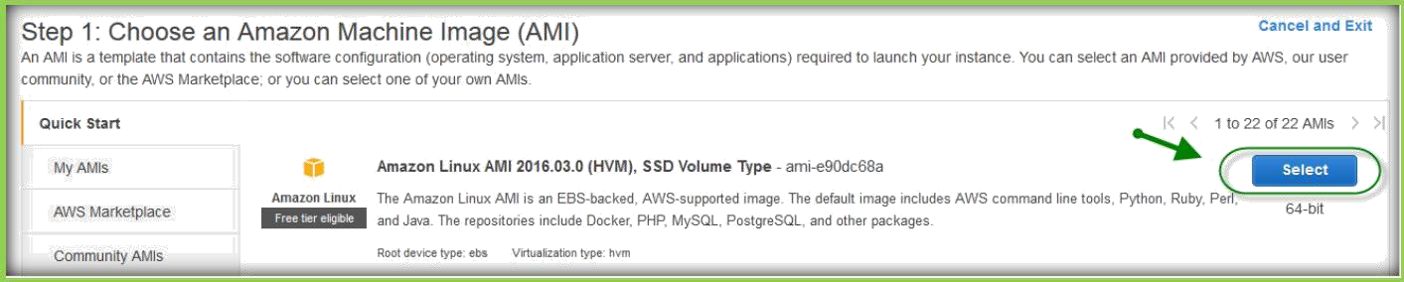
21. BOOT STRAPPING (USER DATA)
When you launch an instance in Amazon EC2, you have the option of passing user data to the instance that can be used to perform common automated configuration tasks and even run scripts after the instance starts.
You can also pass this data into the launch wizard as plain text, as a file (this is useful for launching instances via the command line tools), or as base64-encoded text (for API calls).
Navigate to the EC2 dashboard from the AWS Console and select Instances, located in the left bar under INSTANCES.
Choose Launch Instance to create a new instance.
Choose Amazon Linux AMI from choose an Amazon Machine Image
dashboard click on select.
Choose instance type from the Choose an Instance Type dashboard, then click on Next.

Slide 2
Expand Advanced Details section below of the Configure Instance Details dashboard.
After expanding Advanced Details section, you will find User data section with a text box.

Slide 3
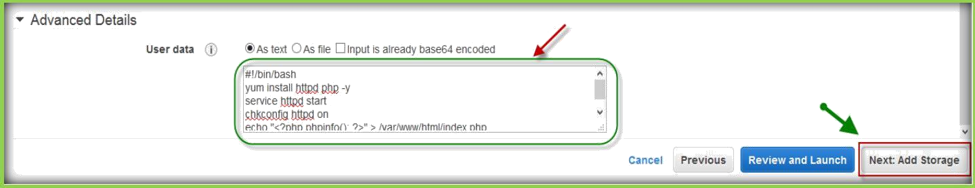
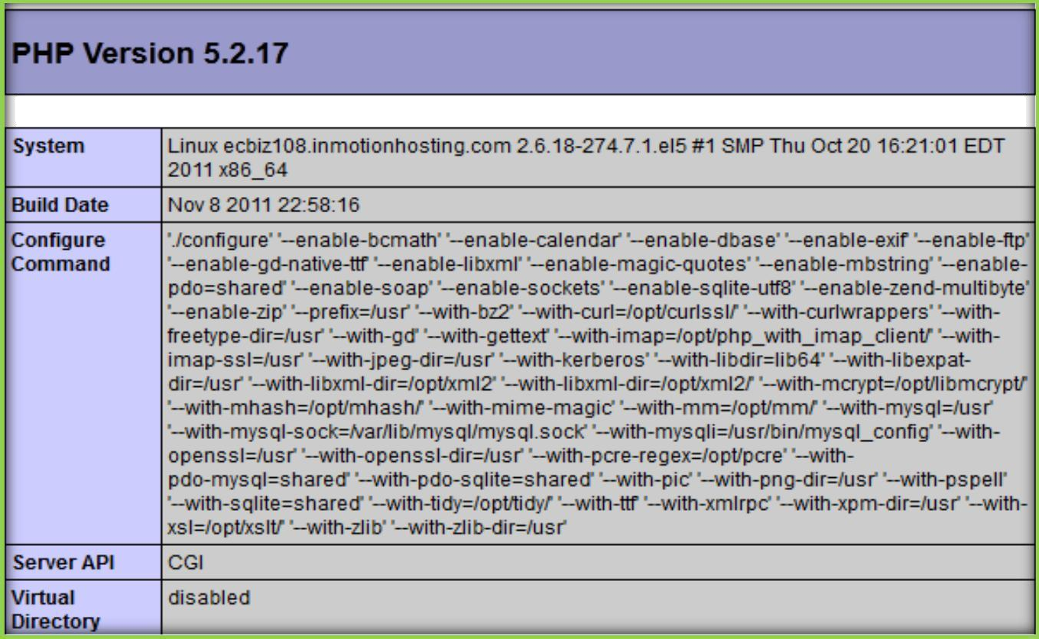
LINUX USER DATA EXAMPLE
Enter the below the commands in the text field, then choose Next.
#!/bin/bash
yum install httpd php -y service httpd start chkconfig httpd on
echo "<?php phpinfo(); ?>" > /var/www/html/index.php
Then go with normal process for creating a new instance, make sure you have selected a security group which has 80(HTTP) port open. Once instance launched, you can browse the IP Address assigned to instance by AWS. You will be displayed with PHP Info page with all PHP settings like below.

Slide 4
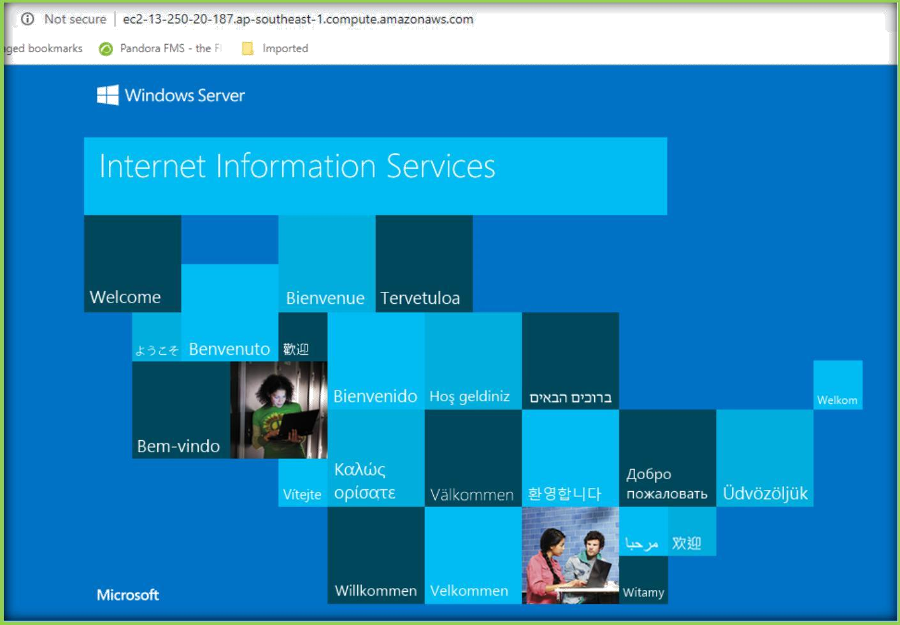
WINDOWS USER DATA EXAMPLE
Enter the below the commands in the text field, then choose Next.
<powershell>
Start-Transcript;
# Install IIS
Import-Module ServerManager;
Enable-WindowsOptionalFeature -Online -NoRestart -FeatureName 'IIS- WebServerRole', 'IIS-WebServer', 'IIS-ManagementConsole';
</powershell>
Then go with normal process for creating a new instance, make sure you have selected a security group which has 80(HTTP) port open.
Once instance launched, you can browse the IP Address assigned to instance by AWS. You will be displayed with default IIS Info page like below.

